Slide 1
Programming with Java/Python
Anan Yaagoub - PhD
Northwestern University

Slide 2
Week 1 - Agenda
Course Introduction
Python: What? Why? Ecosystem? …
Built-in data types – collections
Functional Programming
Extensions
Practice exercise
Code review – Pythonic and Standards

Slide 3
Course Structure
Familiarity with basic syntax, IDE, …
Discuss language specific concepts … differs from other languages, WEB API, WEB Scrape, and OOP
Advanced topics: Threading, functional programming, comprehension, generators, parallel processing, ...
Algorithms and Data Structures
Code snippets and Practice problems
Problem solving and Application development and integration
Extensions to Analytics: Panda
Efficient coding: Performance measures
Coding standards: for future developers
Homework and Projects … do programming

Slide 4
Programming → Problem Solving
The most important skill for a computer scientist is:
  problem solving.
Problem solving means the ability to formulate problems, think creatively about solutions, and express a solution clearly and accurately.
As it turns out, the process of learning to program is an excellent opportunity to practice problem-solving skills.

Slide 5
Course Grading = Programming
6 Homework's:
  60% (10% each)
  Assigned on Thursdays and due in one week time (Friday).
2 Projects:
  Assigned on Thursday and due in 2 weeks time (Friday).
  40% (20% each)
  Can be done in pairs
Grading Criteria:
  Runnable (if program does not run, then no partial points will be given)
  Accuracy (if the results are wrong, then your solution is wrong)
  Usability (easily usable)
  Readability (code style and comments)
  Edges cases (exception handling)
  Performance (code running speed)

Slide 6
Programming with Python
Anan Yaagoub - PhD
Northwestern University

Slide 7
What is Python ?
Python was conceived in the late 1980s
Implementation was started in December 1989 by Guido van Rossum in the Netherlands
Python is an example of a high-level language; other high-level languages are C, C++, C#,PASCAL, FORTRAN, and Java.
Python is a modern, easy-to-learn, object-oriented, procedural, and functional programming language(Hybrid). – different tastes
It has a powerful set of built-in data types, functions and easy-to-use control constructs.
Clean syntax and powerful extensions

Slide 8
Why Python?
Multi-purpose – applications
Interpreted: easily reviewed by simply looking at and describing interactive sessions.
Strongly and Dynamically typed and OO
Focus on readability and productivity
Agile
Cross platform
Slow but extensible in C or C++
Free

Slide 9
The philosophy of Python
The philosophy of Python is captured in the Zen of Python which includes phrases like:
  Beautiful is better than ugly.
  Explicit is better than implicit.
  Simple is better than complex.
  Complex is better than complicated.
  Flat is better than nested.
  Sparse is better than dense.
  Readability counts.
You can see the full Zen of Python in your Python environment by typing:
>>> import this

Slide 10




Compiling and interpreting
Many languages require you to compile (translate) your program into a form that the machine understands.
  Generate machine code in advance, Hard to Debug, Faster
Python is instead directly interpreted into machine instructions.
  Run thru interpreter to generate native code,
  Easy to debug,
  Slower
compile
execute
source code
Hello.java
byte code
Hello.class
output
interpret
source code
Hello.py
output

Slide 11
Python Applications
The Python Package Index (PyPI) hosts thousands of third-party modules for Python.
Both Python's standard library and the community-contributed modules allow for endless possibilities:
  Web and Internet Development
  Database Access
  Desktop GUIs
  Scientific & Numeric
  Education
  Network Programming
  Software & Game Development
  More …

Slide 12
Python Ecosystem
Documentation that you reference
  https://docs.python.org/3/
IDE(notepad, Python, Ipython,Notebook, IDEL, Spyder, ...PyCharm)
Libraries you utilize
  https://pypi.python.org/pypi
The OS you use
Setup and Installation, Setup, upgrade, add
  Third Party Distribution
    Anaconda
    WinPython for Windows
    Canopy: Scientific Python Distribution
    Plus Integrated Analysis Environment
Compilation and Execution
Distribution/Publishing(Sharing)

Slide 13
Which Version & VM to use?
Python and Ipython
Versions 2.7 and 3.x
The Python interpreter or the Python Virtual Machine has a number of different implementations:
  CPython being the main and most popularly installed implementation.
    CPython is the reference implementation for other virtual machines.
  PyPy is Python implemented in Python,
  Jython is implemented in Java and runs on Java VM
  IronPython is the Python implementation for Microsoft .NET Why? Dev. Ext. /use native lib

Slide 14
Ecosystem – Data Science
The SciPy stack: libraries provide support for mathematics, science, and engineering.
  NumPy: performing n-dimensional array manipulation, include support for linear algebra, Fourier transform, and random-number generation.
  SciPy: numerical routines such as integration and optimization
  Matplotlib: provides you with a MATLAB-like interface for creating data presentations of the analysis you perform.
  Sympy: Python library for symbolic mathematics. It aims to become a full-featured computer algebra system (CAS). Integral, limits, equations, series, derivatives, …
  Pandas: library that provides support for data structures and data analysis tools. The library is optimized to perform data science tasks especially fast and efficiently. The basic principle behind pandas is to provide data analysis and modeling support for Python that is similar to other languages, such as R.

Slide 15
Ecosystem …
scikit-learn: Python Ecosystem for Machine Learning
  Community effort - http://scikit-learn.org/
  Classification
  Regression
  Clustering
  Dimensionality reduction
  Model selection
  Preprocessing
Beautiful Soup: This library provides the means for parsing HTML or XML data in a manner that Python understands. It allows you to work with tree-based data.
Others: Graphics, GUI, DB, WEB, … development
  PyQt, Tinker, …

Slide 16
Code Architecture Overview
Programs are composed of modules
Modules contain statements
Statements contain expressions
Expressions create and process objects
Toolbox
  Constructs – reserved keywords
  Built-in functions
  Built-in data types
  Standard libraries
  Extensions - PyPi

Slide 17
Python Built-In Data Types
Atomic Data Types
  Integer, Float, Complex, bool, byte, …
  Immutable
  Integer has no size limitation, others depend on C implementation
Collection/Container data type
  Sequence types
    lists – the most popular container data type in python; can store any number of any objects
    string, a sequence of Unicode characters
    tuples – similar to list, yet once created are immutable
    bytes – immutable sequence of integers in the range 0 <= x < 256
    bytearray – like bytes, but mutable
  Set types
    sets – can store only unique elements,
  Mapping types
    dictionary – also known as associative arrays. They contain mapping of keys into value

Slide 18
Everything is an object
Everything means everything, including functions and classes
Data type is a property of the object and not of the variable
>>> x = 7
>>> x
7
>>> x = 'hello'
>>> x
'hello'
>>>

Slide 19
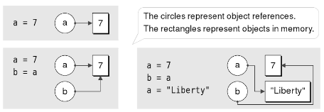
Mutable and immutable objects
objects in Python can be mutable or immutable.
immutable collection can hold mutable objects (e.g. an tuple holding lists).
Variable = object reference.

Slide 20
Collection Ordering
Container object can store their content in either an ordered or unordered manner.
Sequences have a deterministic ordering.
  Lists, tuples, and strings are sequences. Things come out of them in the same order they were put in.
Sets and Maps ordering of items is arbitrary. (It's not random)
  Set objects are unique
  Map key is unique

Slide 21
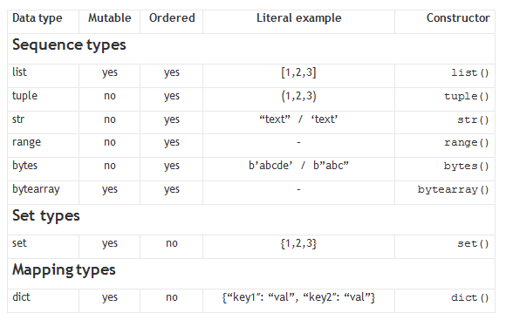
Python built-in container types cheat-sheet

Slide 22
Lists
Ordered collection of data
Data can be of different types
Lists are mutable
Issues with shared references and mutability
Same subset operations as Strings
>>> x = [1,'hello', (3 + 2j)]
>>> x
[1, 'hello', (3+2j)]
>>> x[2]
(3+2j)
>>> x[0:2]
[1, 'hello']

Slide 23
Mutable vs. immutable objects
Lists are mutable objects.
Strings are immutable objects.
(So are numbers.)
>>> L = [2,1,3]
>>> L.sort()
>>> L
[1,2,3]
>>> s = 'string'
>>> s.replace('st','')
'ring'
>>> s
'string'
no return value
returns a NEW string
L has changed.
s has NOT changed

Slide 24
+= mutates Mutable Data (lists)
WARNING: For mutable data types, the following are NOT the same
MUTATES A
(B changes too)
A = []
B = A
A += [42, 42]
NOT THE SAME!
A = []
B = A
A = A + [42, 42]
COPIES A
(B does not change)

Slide 25
Lists vs. Dictionaries
Lists are not perfect…
reference
You can't choose what to name data.
L
5
42
L[0]
L[1]
L[0], L[1], …
You have to start at 0.
L[1988] = 'dragon'
L[1989] = 'snake'
Some operations can be slow for big lists …
if 'dragon' in L:

Slide 26
Lists vs. Dictionaries
In Python a dictionary is a set of key - value pairs.
>>> d = {}
>>> d[1988] = 'dragon'
>>> d[1989] = 'snake'
>>> d
{1988: 'dragon', 1989: 'snake'}
>>> d[1988]
'dragon'
>>> d[1987]
key error
creates an empty dictionary, d
1988 is the key
'dragon' is the value
1989 is the key
'snake' is the value
Anyone seen this before?
Retrieve data as with lists…
or almost !
It's a list where the index can be any immutable-type key.

Slide 27
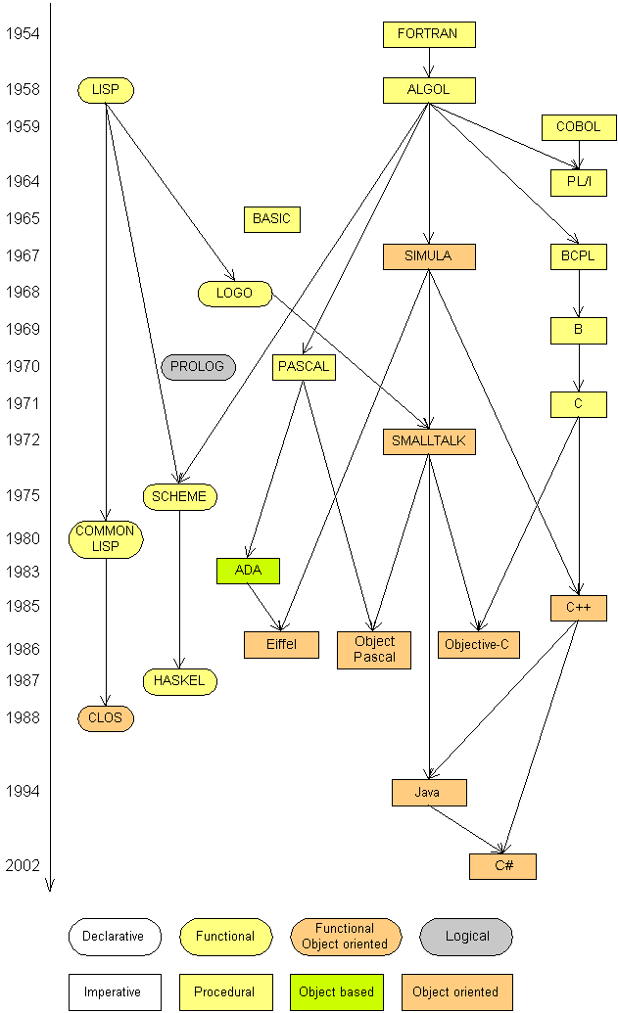
Programming Languages
Some influential ones:
  FORTRAN
    science / engineering
  COBOL
    business data
  LISP
    logic and AI
  BASIC
    a simple language

Slide 28
Programming Languages Paradigm
Style or programming and the problem decomposition
Programming languages support decomposing problems in several different ways:
  Procedural/imperative: allows side effects.
  Declarative: specification that describes the problem.
  Object-oriented: collections of objects that have internal state and support methods .
  Functional programming decomposes a problem into a set of functions. Ideally, functions only take inputs and produce outputs, and don’t have any internal state that affects the output produced for a given input. (pure functional-disallows side effects)
Python is multi-paradigm language: it supports imperative, OO and functional programming paradigms.

Slide 29
Functional Programming
What is (pure) functional programming?
  Solution is a collection of functions
  Function call other functions
  Function can be passed as parameters
  Function Chaining.
  Language support High-order functions and objects
Advantageous properties of functional programs:
  Code is clearer and more compact.
  Parallelization means running the same code concurrently without synchronization. (on multiple processors).
  Lazy evaluation is a compiler technique that avoids running code until the result is needed. (i.e. Generators)
  A process is deterministic if repetitions yield the same result every time. (Less bugs)
  Ease of debugging and testing
  Performance (C vs core Python)

Slide 30
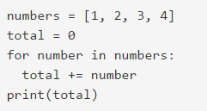


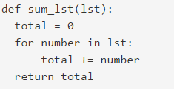
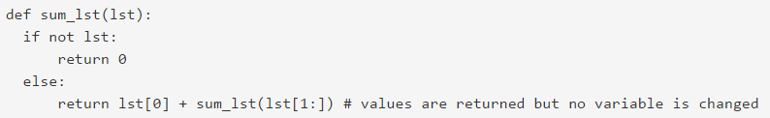
Basic concepts of functional programming
expressions vs statements: The first one means that the code should tell what it aims to do instead of how to do it
the lack of data mutation: once a variable assumes a value it will never change on the course of the program execution

Slide 31
Python features that makes a foundation for writing functional-style programs
Iterators:Data Types That Support Iterators
  An iterator is an object representing a stream of data; this object returns the data one element at a time.
  The built-in iter() function takes an arbitrary object and tries to return an iterator that will return the object’s contents or elements, raising TypeError if the object doesn’t support iteration.
  Several of Python’s built-in data types support iteration, the most common being lists and dictionaries.
  An object is called iterable if you can get an iterator for it.
Generator expressions and list comprehensions
  declarative way of using loops to iterate over collections
  epression for exp in iterable if condition
  perform some operation for every element
  select a subset of elements that meet some condition
Generators – functions
  return an iterator that returns a stream of values.

Slide 32
Python features Cont …
Functions are first class objects
Higher-Order built-in functions
  map(), filter(), zip(), sorted(), sum(), …
Lambda – anonymous function
  used when passing a simple function as an argument to another function
The operator module
  set of functions corresponding to Python’s operators. These functions are often useful in functional-style code because they save you from writing trivial functions that perform a single operation.
The functools module
  Set of functions that takes one or more functions as input and returns a new function.
  Example: functools.partial() function.
The itertools module

Slide 33
Function Basics
def max(x,y) :
if x < y :
return x
else :
return y
max(3,5)
5
max('hello', 'there')
'there'
max(3, 'hello')
'hello'

Slide 34
Functions are first class objects
Can be assigned to a variable
Can be passed as a parameter
Can be returned from a function
Functions are treated like any other variable in Python, the def statement simply assigns a function to a variable

Slide 35
Function names are like any variable
Functions are objects
The same reference rules hold for them as for other objects
>>> x = 10
>>> x
10
>>> def x () :
... print 'hello'
>>> x
<function x at 0x619f0>
>>> x()
hello
>>> x = 'blah'
>>> x
'blah'

Slide 36
Functions as Parameters
def foo(f, a) :
return f(a)
def bar(x) :
return x * x
>>> foo(bar, 3)
9
Note that the function foo takes two parameters and applies the first as a function with the second as its parameter

Slide 37
Functions Returning Functions
def foo (x) :
def bar(y) :
return x + y
return bar
f = foo(3)
print f(2)
5

Slide 38
Parameters: Defaults
Parameters can be assigned default values
They are overridden if a parameter is given for them
The type of the default doesn’t limit the type of a parameter
def foo(x = 3) :
... print x
...
foo()
3
foo(10)
10
foo('hello')
hello

Slide 39
Parameters: Named
Call by name
Any positional arguments must come before named ones in a call
>>> def foo (a,b,c) :
... print a, b, c
...
>>> foo(c = 10, a = 2, b = 14)
2 14 10
>>> foo(3, c = 2, b = 19)
3 19 2

Slide 40
Anonymous Functions
A lambda expression returns a function object
The body can only be a simple expression, not complex statements
f = lambda x,y : x + y
f(2,3)
5
lst = ['one', lambda x : x * x, 3]
lst[1](4)
16

Slide 41
Higher-Order Functions
map(func,seq) – for all i, applies func(seq[i]) and returns the corresponding sequence of the calculated results.
lst = [0,1,2,3,4,5,6,7,8,9]
map(double,lst)
[0,2,4,6,8,10,12,14,16,18]
def double(x):
return 2*x

Slide 42
Higher-Order Functions
filter(boolfunc,seq) – returns a sequence containing all those items in seq for which boolfunc is True.
def even(x):
return ((x%2 == 0)
lst = [0,1,2,3,4,5,6,7,8,9]
filter(even,lst)
[0,2,4,6,8]

Slide 43
Higher-Order Functions
reduce(func,seq) – applies func to the items of seq, from left to right, two-at-time, to reduce the seq to a single value.
def plus(x,y):
return (x + y)
lst = [‘h’,’e’,’l’,’l’,’o’]
reduce(plus,lst)
‘hello’

